Slide 1
Usage of the irods-Csharp Library

Slide 2
Index
Glossary - 3
Session startup - 4-6
Using Collections - 7-11
Using Data Objects - 12-15
Adding Metadata - 16-17
Performing Queries - 18-23
Logging - 24
Final notes - 25

Slide 3
Glossary
Collection - iRODS equivalent of directory, stores data objects or more collections.
Data Object - iRODS equivalent of a file. Data Objects can have multiple physical copies as backups in the iRODS backend, but appear as a single file to the user.
Metadata - Tags that can be added to collections and data objects. Metadata has the following three components: a Name, a Value and an amount of Units. The Units is optional.

Slide 4
Session Startup
For any action that the user wishes to perform on the IRODS server, a session object is required
The session contains the following objects that contain operations corresponding to that category:
IrodsSession.Collections
IrodsSession.DataObjects
IrodsSession.Queries
IrodsSession.Meta

Slide 5
Session Startup - Authentication
When starting a new session, authentication parameters are required to authenticate with the server. The parameters required are:
host : string - Domain name of server host
port : int - Port on which server can be reached
home : string - Collection name of home directory
user : string - User name of user
zone : string - Zone name of server
scheme : string - Authentication scheme to be used (Currently only “pam” is supported)

Slide 6
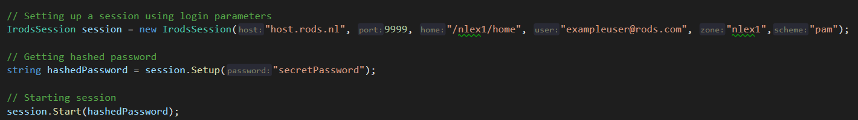
Session Startup - Starting a connection
When a session has been created, the session needs to be set up using the users password. The setup method will return a hashed password.
This hashed password can then be used to start the session after which the session is ready to be used.
Code snippet of full session setup:

Slide 7
Using Collections - Methods
Methods regarding collections are located within the collection manager of the session : IrodsSession.Collections
It contains the following methods:
Rename - Rename a collection
Open - Returns a collection object for the specified path
Create - Creates new collection at specified path
Remove - Removes collection at specified path

Slide 8
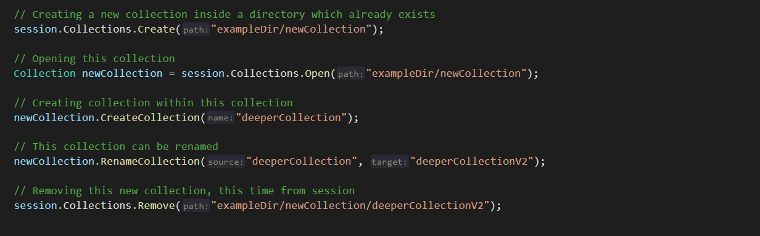
Using Collections - Creating and opening collections
From the session, a new collection can be created, after which it can be opened. When opening a collection, a Collection object is returned which can be used to perform actions inside the corresponding collection.

Slide 9
Using Collections - The Collection class
Collection objects house almost every method available within the iRods_Csharp library. The advantage of using a collection object is that the methods that it contains will be executed using the collection’s path as location for executing the method.
For example, when creating a new collection using session.Collections, one would need to pass two parameters, the path of the collection where the new collection should be created and the name of the new collection. When using a collection object, only the name of the new collection is needed, the collection is created inside of the collection object’s path.

Slide 10
Using Collections - The Collection class 2
The collection class also houses some methods not available in session.Collections:
Collection.ChangeDirectory - Changes collection directory, as one would do using cd
Collection.Rename - Changes the current collection’s name
Collection.PrintDirectory - Returns string of the currents collections’ path
Collection.Meta - Returns array of metadatas attached to this collection

Slide 11
Using Collections - The Collection class 3
From a Collection object, the following methods are available which perform methods from IrodsSession.DataObjects using its own path as starting point:
Collection.OpenCollection
Collection.RenameCollection
Collection.CreateCollection
Collection.RemoveCollection

Slide 12
Using Data Objects
Methods regarding data objects are found within the DataObject manager of the session : IrodsSession.DataObjects
It contains the following methods:
Open - Returns DataObject object for the specified path and name (requires filemode Read, Write or ReadWrite from Options.FileMode enum)
Create - Creates new data object in specified path
Write - Writes byte array to specified file
Read - Returns byte array with content of specified file
Remove - Removes specified file

Slide 13
Using Data Objects - The DataObj Class
When opening a data object with IrodsSession.DataObjects.Open, a DataObj Object is returned. This object contains the following methods:
DataObj.Write - Write byte array to this file
DataObj.Insert - Write byte array at the beginning of this file
DataObj.Seek - Offset the file pointer from start, current offset or end (seekmode)
DataObj.Read - Returns byte array with contents of this file
DataObj.Remove - Removes this file
DataObj.Meta - Returns an array of metadatas attached to this data object

Slide 14
Using Data Objects - Access from Collection Object
From a collection object, the following methods are available which perform methods from IrodsSession.DataObjects using its own path as starting point:
Collection.OpenDataObj
Collection.RenameDataObj
Collection.CreateDataObj
Collection.WriteDataObj
Collection.ReadDataObj
Collection.RemoveDataObj

Slide 15
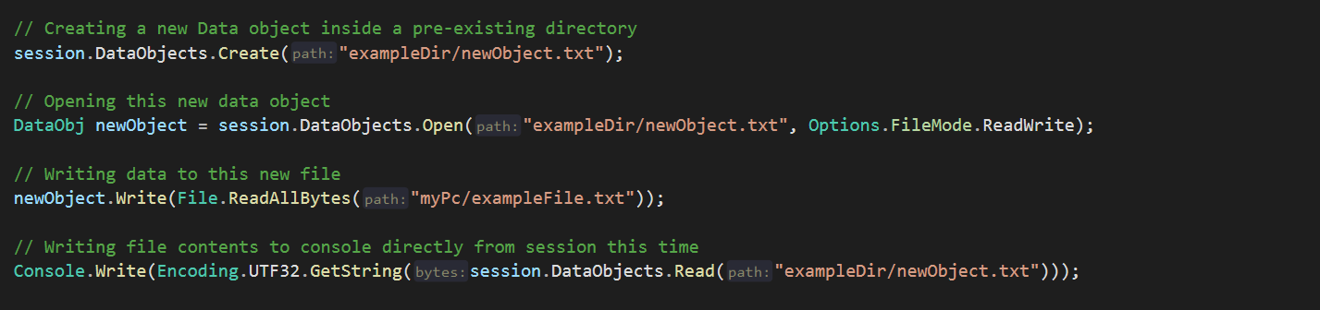
Using Data Objects - Code snippet
Below is an example for using the Data Object functionality:

Slide 16
Adding Metadata
Metadata can be added to Collections or Data Objects using the MetaManager in IrodsSession: IrodsSession.Meta
It contains the following methods:
AddMeta - Adds meta Name, Value and (optionally) Units triple
RemoveMeta - Removes meta Name, Value and (optionally) Units triple
Units are optional. However, they won’t stack. Adding triple <name,value,1> to an object which already has a tag <name,value,2> will result in the object having both tags attached to it as unique tags. To use these methods, the user needs to supply either a DataObj or Collection Object and the meta values, or call the methods directly from these objects.

Slide 17
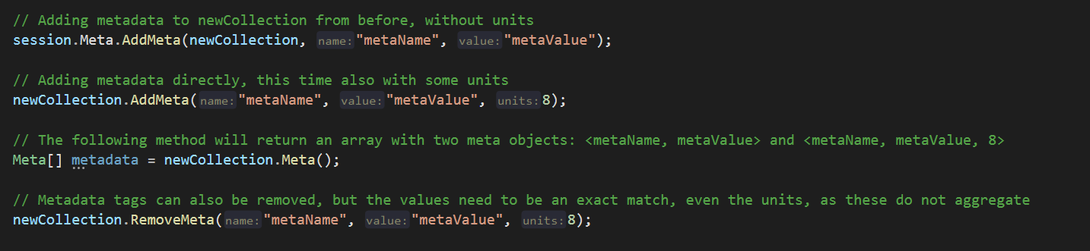
Adding Metadata - Code snippet
Below is a small example of adding metadata to collections and data objects

Slide 18
Performing Queries
Methods to query data are found in the query manager of the IrodsSession : IrodsSession.Queries
It contains the following methods:
QueryCollection - query collections based on name
MQueryCollection - query collections based on metadata
QueryObj - query objects based on name
MQueryObj - query objects based on metadata
QueryMeta - query meta tags for collection or data objects

Slide 19
Performing Queries - Collections and Data Objects
When using the QueryCollection and QueryObj methods, the a name and a path need to be provided. The query will search for all collections or data objects within that path or deeper that contain the provided name in their path.
For example, consider the path “home/collection” and name “example”
Executing the method session.Queries.QueryCollection(“home/collection”, “example”);
Might return an array of collections with the following paths:
“home/collection/example”
“home/collection/abcexample12”
“home/collection/example/nestedCollection”

Slide 20
Performing Queries - Queries based on metadata
MQueryCollection and MQueryObj will perform a query to find collections or data objects which are tagged with metadata with the specified values.
It is not required to specify all three parts of the metadata triple
For example, one could query all objects with a specific metadata triple session.Queries.MQueryObj(“path”, “name”,”value”,1);
But if the user would like to query all objects which have metadata that matches a certain metadata value, then the user would need to specify it wants to query based on metadata value: session.Queries.MQueryObj(“path”, metaValue : “value”);

Slide 21
Performing Queries - Querying metadata
Querying metadata attached to a collection or data object can be done either by calling IrodsSession.Queries.QueryMeta using the path, name and type of the object (e.g. -c or -d), or by calling the .Meta() function of a Collection or Data Object object:
Collection.Meta() and DataObj.Meta()

Slide 22
Performing Queries - Access from Collection object
As with most methods that have a path as paramenter, the query methods can also be called directly from a collection object. The following methods are supported:
Collection.QueryCollection
Collection.MQueryCollection
Collection.QueryObj
Collection.MQueryObj

Slide 23
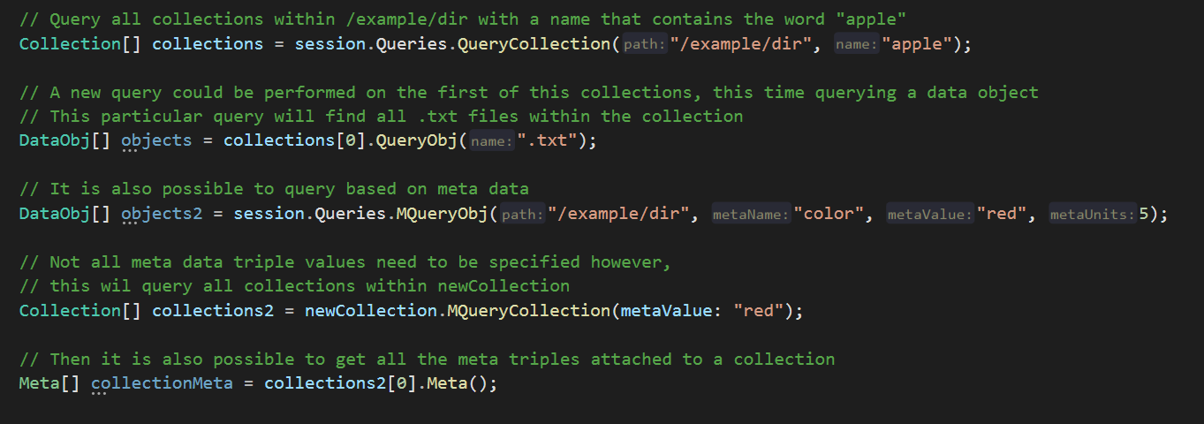
Performing Queries - Example code snippet
Below is a small code snippet showing the query functionality

Slide 24
Logging
There are two TextWriters in the Utility class which are set to null by default:
Utility.Log and Utility.Text
Utility.Log is used by the library to write debugging data such as messages that are sent to and received from the server, Utility.Text can be used to write a line with a console color by using the Utility.WriteText method
For example, to make sure the library writes debug data to the console, simply set the logger: Utility.Log = Console.Out;

Slide 25
Final Notes
These slides were written to explain and showcase functionality of the first version of the irods-Csharp library. In the future, these slides may become incomplete or incorrect.
For any questions regarding the use of the library, please mail to:
h.fidder2@students.uu.nl

